Slide 1

QLD Vacancy Days Analysis in Public Housing
PROJECT 1
Alistair, Kaushal, Parvez and Selina

Slide 2
Definition
Vacancy Days – The number of days between the date such existing tenant vacates
Tenantable - Fit for occupation by a tenant.
Untenantable - Incapable of being occupied or lived in
VUDays - Number of days the property was vacant and untenantable
VTDays – Number of days the property was vacant and tenantable

Slide 3
Types of Housing
Detached house
A house with 2 or more bedrooms on 1 block of land.
Duplex
Usually 2 units, with 1–3 bedrooms in each, divided by a common wall, located on 1 block of land.
Dual occupancy
2 properties located on one block of land.
Cluster house
A number of attached or separate homes, with 2–4 bedrooms in each, located within a housing development.
Townhouse
3 or more units next to each other, with 1–4 bedrooms in each, divided by common walls.
Apartment / flat / unit
Usually a complex of 2 or more storeys, with 1–3 bedrooms in each.
Seniors’ unit
For people over the age of 55, usually in a complex of 1–2 storeys, with 1–2 bedrooms in each.
→ https://www.qld.gov.au/housing/public-community-housing/eligibility-applying-for-housing/eligibility-for-housing/types-of-houses-provided

Slide 4
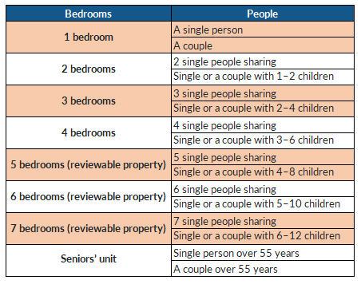
Bedroom entitlements
The number of bedrooms in the property
listed on the housing register
for is based on:
Number of people within your household
Gender of the people in your household
Age of the people in your household.
https://www.qld.gov.au/housing/public-community-housing/eligibility-applying-for-housing/eligibility-for-housing/types-of-houses-provided

Slide 5
Project Objectives
(1) What are the vacant days across 5 year period in QLD housing sector?
(2) What was the status of the dwelling during vacant days (tenantable and untenable)?
(3) How does unit size affect vacancy days?
(4) How does dwelling type affects the vacancy days? (Graph 4 to 6)
(5) Are there any factors that affected the vacancy days trend?

Slide 6
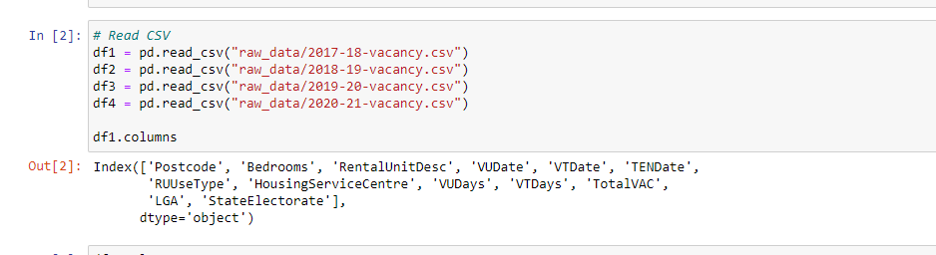
Data Clean-up and Exploration
- Data collecting from data.gov.au
- As per our Data collection reading the Csv file.

Slide 7
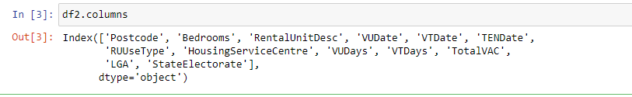
Data Clean-up and Exploration
- Check all the data frame with the same column name and same column sequence

Slide 8
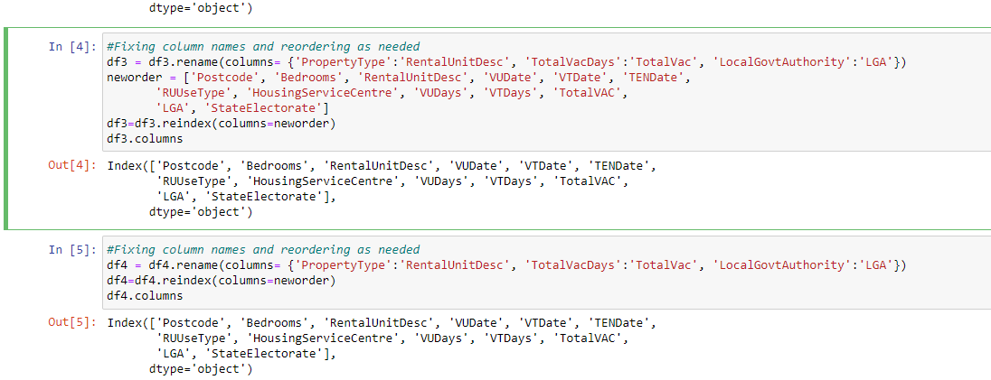
Data Clean-up and Exploration
- Change the difference of the columns of the data frame by renaming and changing oreders

Slide 9
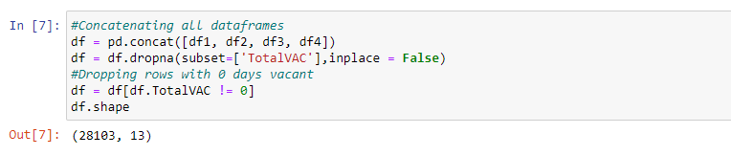
Data Clean-up and Exploration
- Drop all zero value rows of column Total Vacant Days

Slide 10
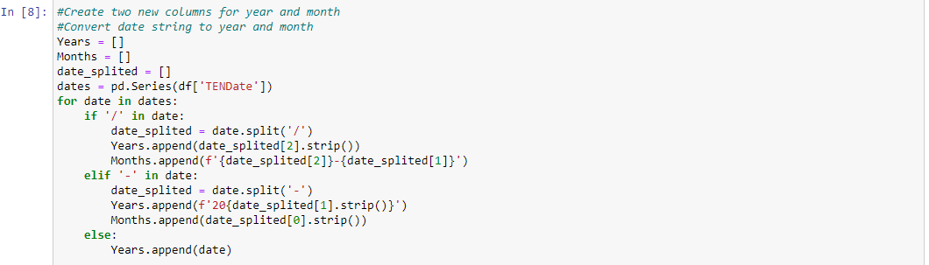
Data Clean-up and Exportation
- Create two new column Year and Months getting dates from the Dataframe

Slide 11
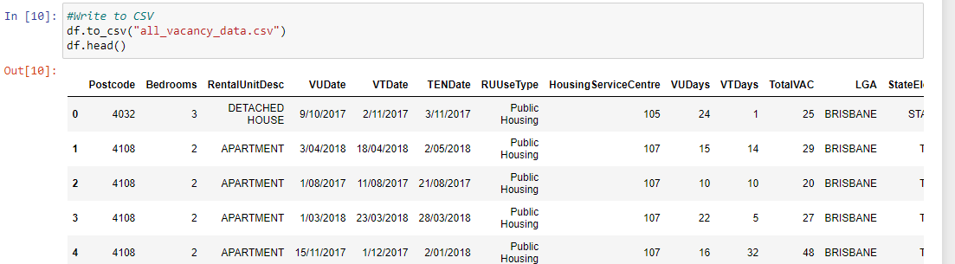
Data Cleanup and Exploration
- Save all data frame in new Csv file.

Slide 12
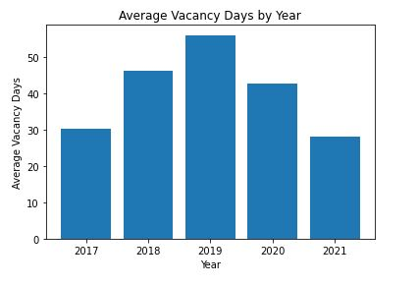
Average Vacancy Days by Year
-The Days on market called as DOM as well.
- In this Slide we would like to explain that how the average vacancy days increase and decrease by year.
- As we can see beginning of the 2020 vacancy rate dropping down around 45days and it still going down in 2021 which is approx. 30days.

Slide 13
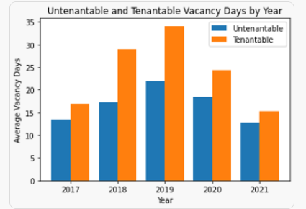
Untenantable and Tenantable Vacancy Days by Year
- In this graph as we are trying to compare the tenantable and untenantable house vacancy days by year.
-As we can see in 2017 graph shows a tenantable vacancy rate is increasing up to the end of the 2019 which going up to the 33 days and suddenly it going down in 2020 and 2021. In the other side untenantable is gradually increasing and decreasing during all this year but doesn’t have drastic change as like tenable.

Slide 14
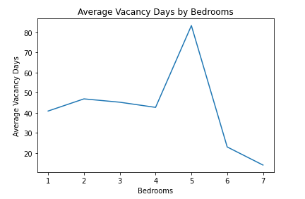
Average Vacancy Days by Bedrooms
- In this slide we are trying to explain the average vacancy days by bedroom and we found almost a trend but the 5 bedroom house which had more vacancy days than others.

Slide 15
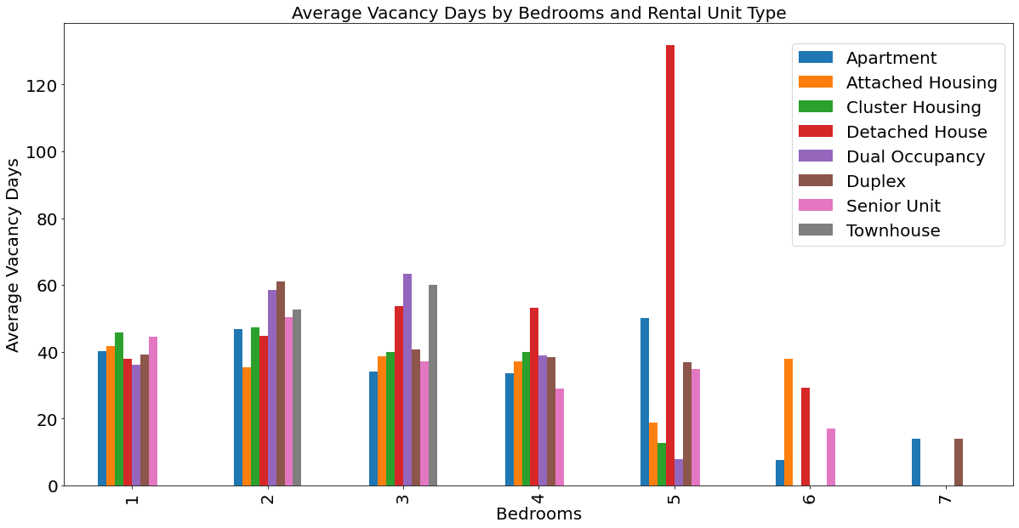
Housing types and bedroom comparison
We can clearly see that 5 Bedrooms Detached House bar is way too big compare to others.

Slide 16
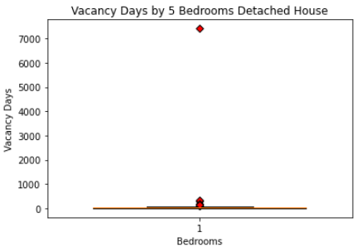
Outliers of vacancy days against bedrooms
Investigate the potential outliers of 5 Bedrooms Detached House data. And find below Outliers.
Potential outlier are:
Index Vacant Days
13838 7412
21461 326
12916 287
21753 188
26734 164
13754 124
12534 119
14398 103
21662 95

Slide 17
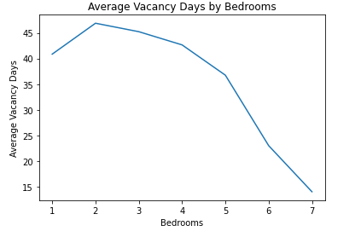
Average Vacancy Days against bedrooms
Removed top 3 outliers ( 7412, 326, 287)
Now the plot shows a clear trend that the houses with more bedrooms numbers stays vacant in the market for lesser days.

Slide 18
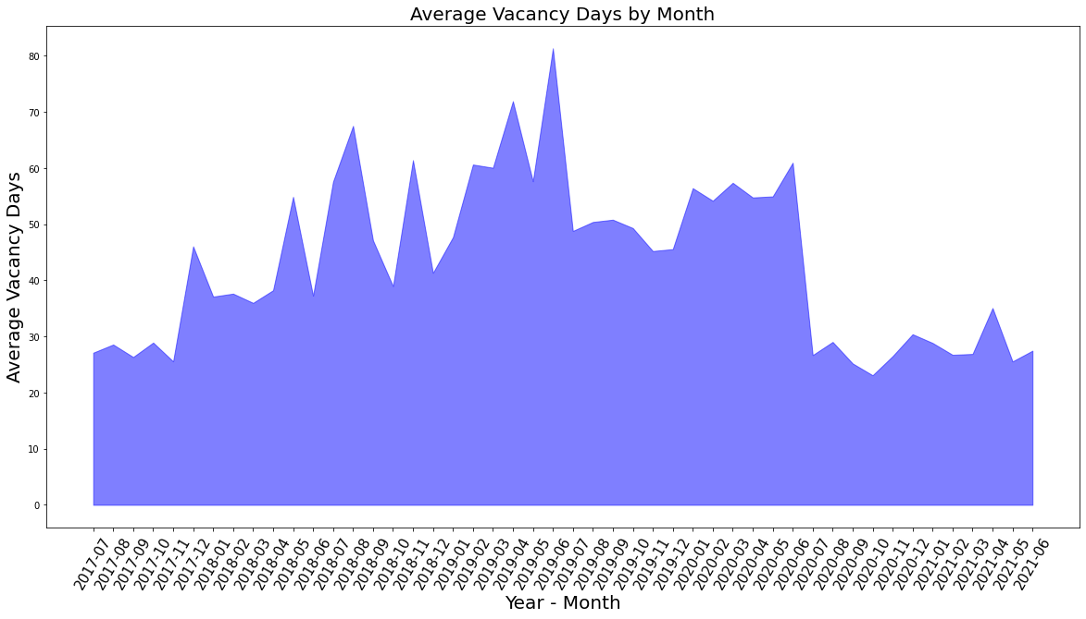
Average Vacancy Days by Month
Sudden drop

Slide 19
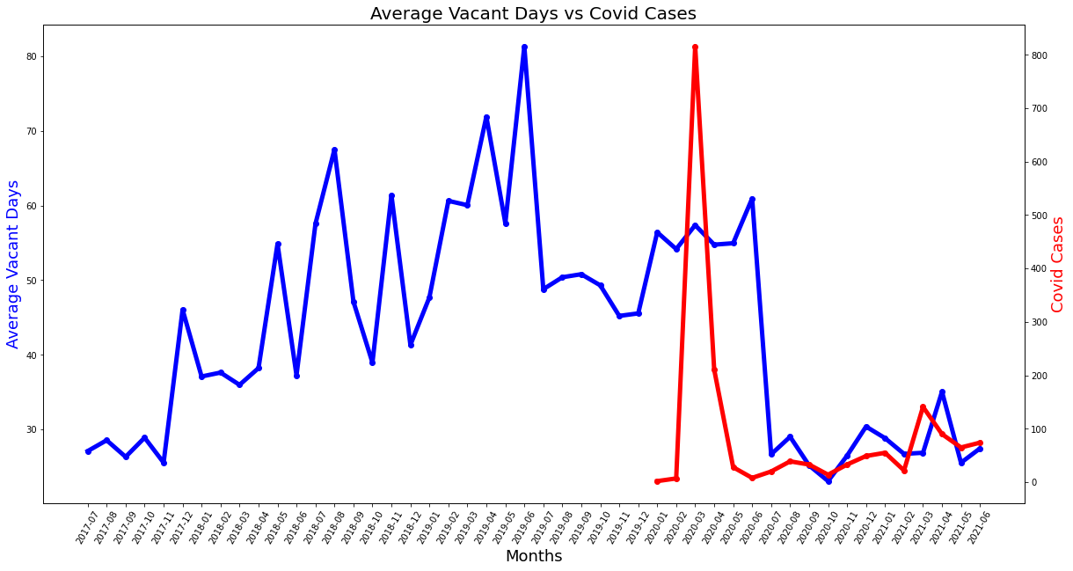
Affects of Housing from Covid
Sudden drop due to high Covid Cases

Slide 20
QLD Housing Vacancy – Data Limitations
1. Missing data | 2. Lack of context | 3. Time constraints | 4. Awareness of government policies
- Approximately 1500 rows of data were dropped due to some columns being blank | - No insight into the reason for the property’s status | - Comparisons to unrelated data would provide more evidence and support to any conclusions drawn | - We are not familiar with the government policies surrounding social housing in QLD
- This amounts to around 5% of our total data | - Unable to address core issues due to this | - Lack of available data and time constraints meant that we were unable to add different datasets for comparison | - Policies that were in place pre-COVID may have been changed or modified, affecting the results
 | - Demand for certain types of housing is not accounted for

Slide 21
Discussion on Results
Upward trend of average number of vacant days from 2017-2019
Downward trend from the peak of 2019 could be due to the pandemic
Majority of vacant days have the property in the status of tenantable
Data shows that the number of days a property is vacant falls as the number of bedrooms increases

Slide 22
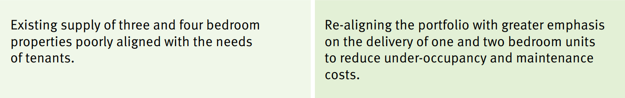
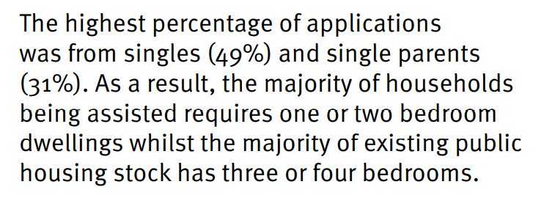
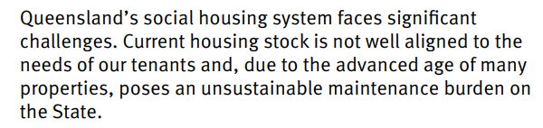

Conclusion
The effects of COVID most likely played a role in the later data we got
Presumably other factors were involved, but more investigation is needed
The number of days a property was left vacant but tenantable was higher than expected, especially when considering the context of how many more properties are needed and how long the current waitlist is
Sources: Housing 2020 report, Queensland Housing Strategy 2017-2020 Action Plan

